Slide 1


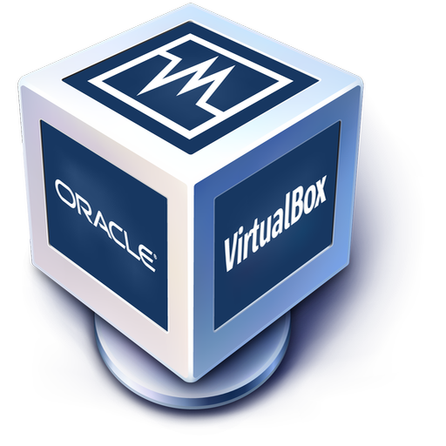
MacOS VM Setup Tutorial

Slide 2
Helpful links
Website with text instructions for macOS ISO by geekrar
Virtualbox Video Tutorial Recorded by Calvin
Mac Support Page

Slide 3
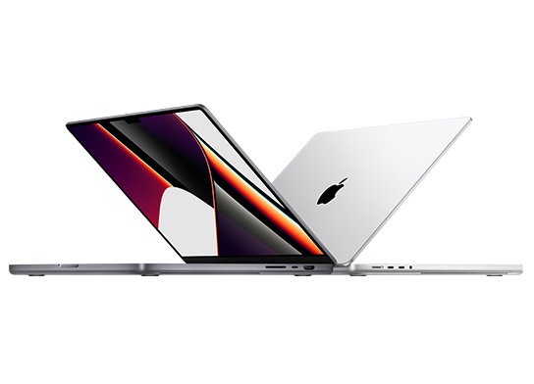
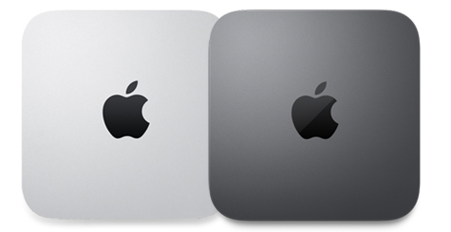
Grab your Mac (Or a friends)

Slide 4
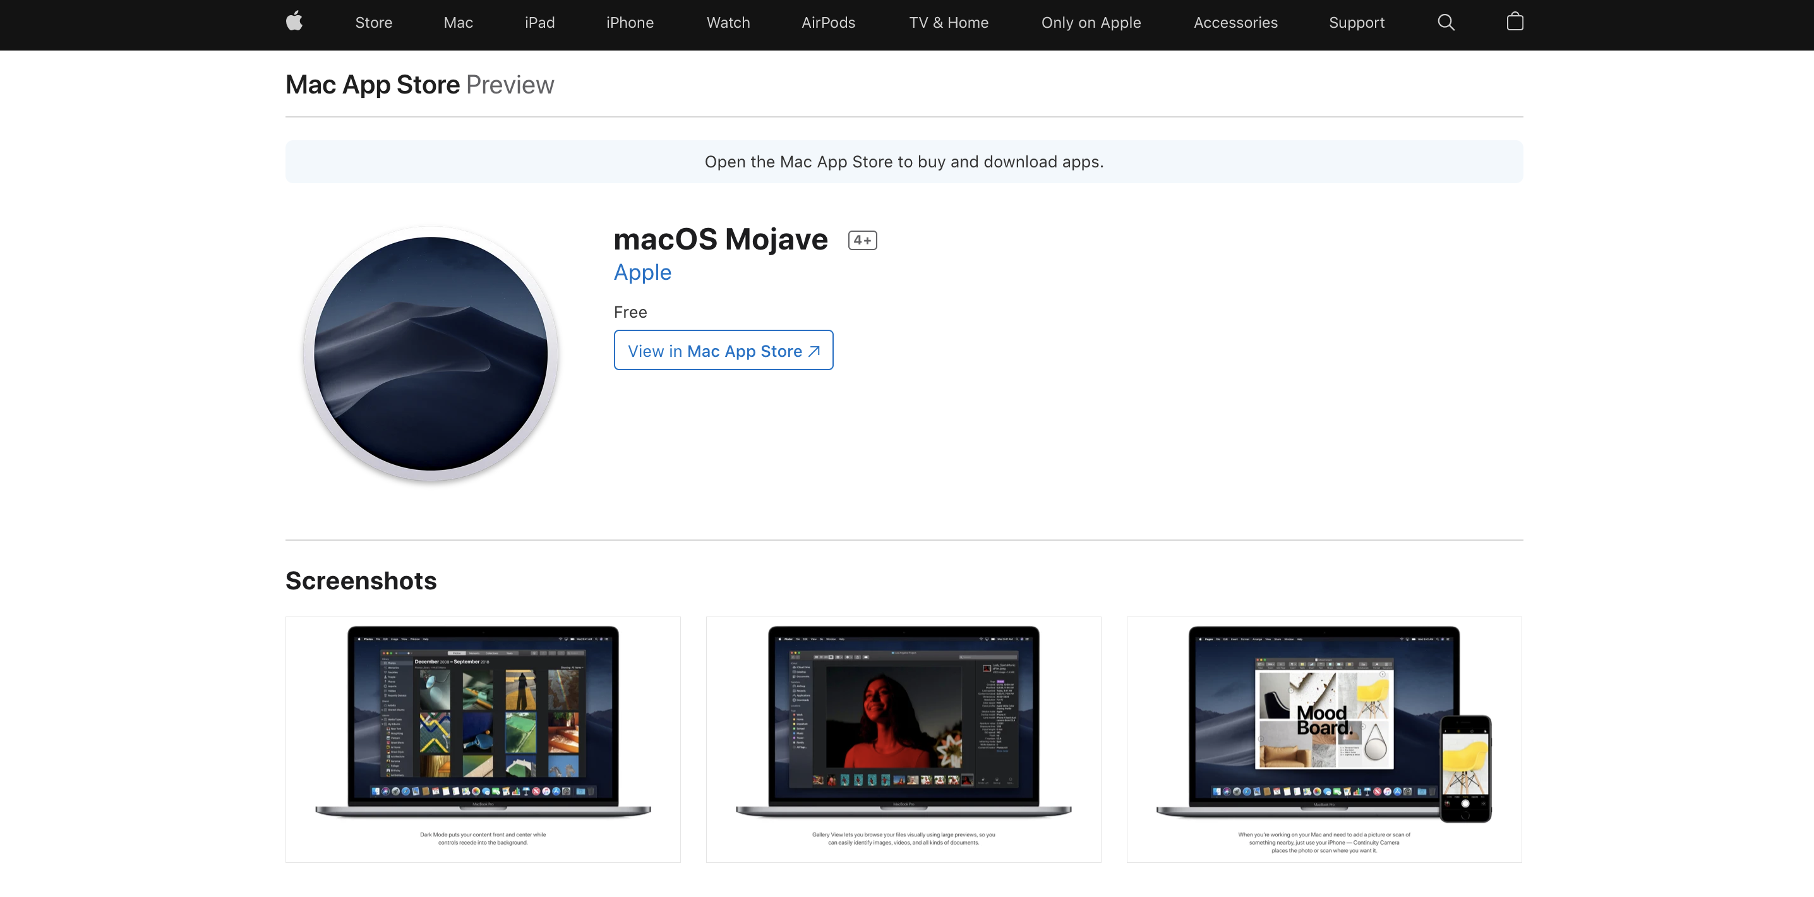
Download the macOS Installer
Mojave Installer
Monterrey Installer
Mac Support Page

Slide 5
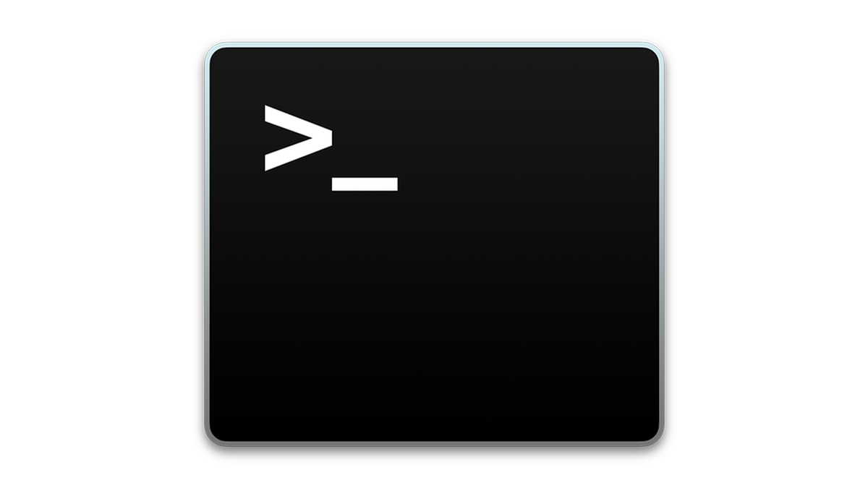
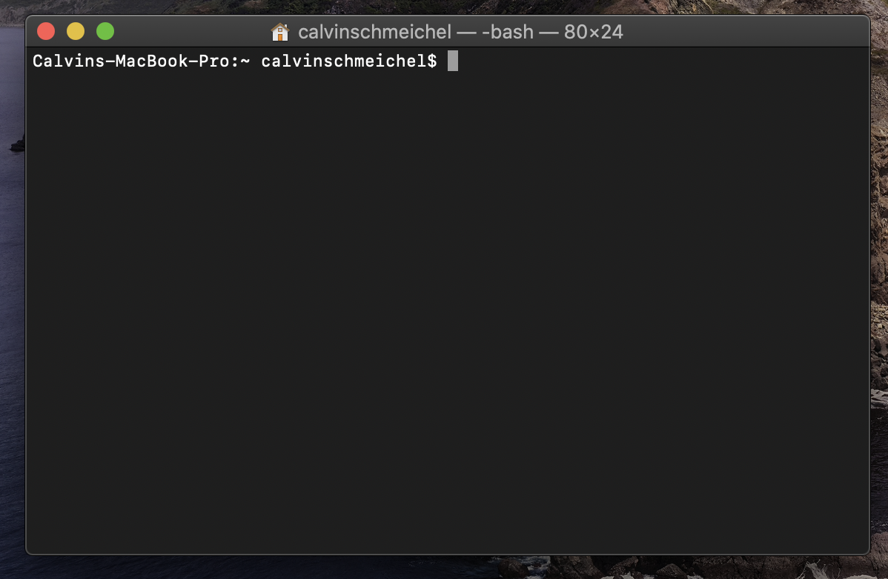
Command Setup
Open Terminal and make sure your logged in

Slide 6
1. Create DMG Disk with Terminal
hdiutil create -o /tmp/mojave -size 7900m -volname mojave -layout SPUD -fs HFS+J

Slide 7
2. Mount DMG Disk to your macOS
hdiutil attach /tmp/mojave.dmg -noverify -mountpoint /Volumes/mojave

Slide 8
3. Create macOS Mojave Installer
sudo /Applications/Install\ macOS\ Mojave.app/Contents/Resources/createinstallmedia --volume
/Volumes/mojave --nointeraction

Slide 9
4. Unmount Disk
hdiutil detach /volumes/Install\ macOS\ mojave

Slide 10
5. Convert DMG Disk to ISO Disk
hdiutil convert /tmp/mojave.dmg -format UDTO -o ~/Desktop/mojave.cdr

Slide 11
6.Rename and Move Image File to macOS Desktop
mv ~/Desktop/mojave.cdr ~/Desktop/mojave.iso

Slide 12
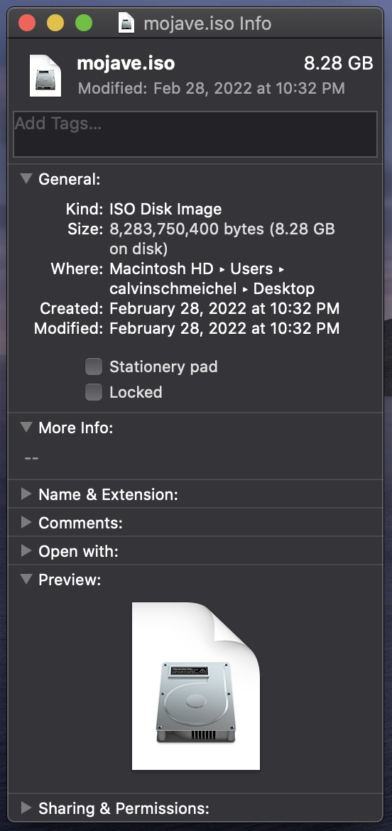
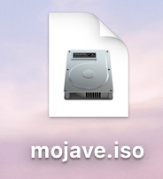
Now you should have the ISO on your desktop

Slide 13
Download VMware From On The Hub
https://stcloudstate.onthehub.com/
Login
Search for "VMware Workstation 16.x Pro"
Add to cart
Checkout
Save key
Download VMware via the download provided by on the Hub
Install from the download
Input the key given previously wen prompted
You have VMware for a year!

Slide 14
VMware Setup
DrDonk/unlocker: VMware macOS utilities (github.com)
github.com/DrDonk/unlocker
This is an unlocker for MacOS in VMWare. VMware cannot legally have an environment option available by default. After using tool, you simply need to select the mac environment from the list.

Slide 15
Configuring MacOS On VMWare
New machine
At least 8 Gibibytes of ram
At least 2 cores
Select Mac OS option

Slide 16

VirtualBox Setup
VirtualBox Download
VirtualBox Extension Pack

Slide 17
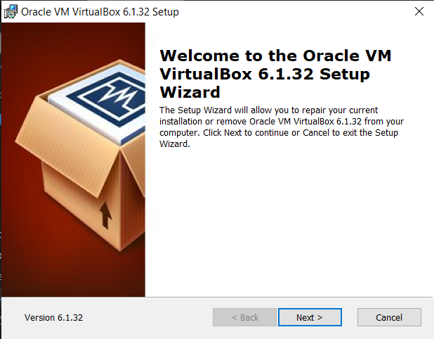
Install Virtual Box

Slide 18
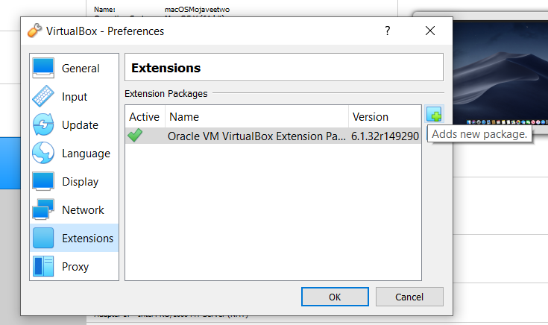
First add the extension pack
File < Preferences < Extensions < "Green Plus Button" and select the extension pack you just downloaded

Slide 19
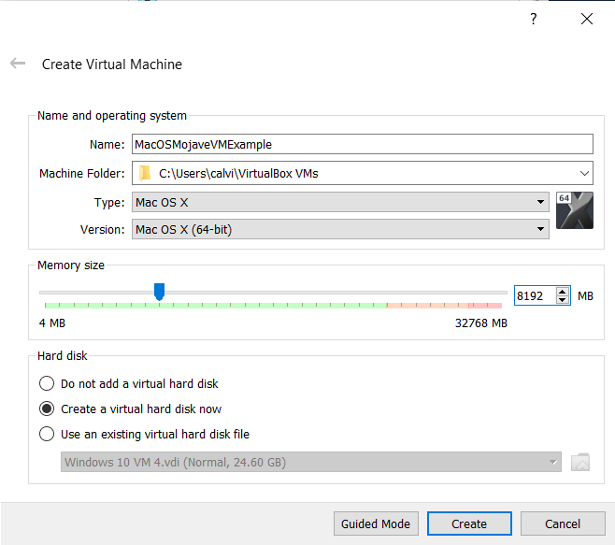
Creating the VM
Click the "New" button
Name your VM (Make sure to note the
exact name it will be used later)
Type: MacOS X
Version: MacOS X (64-bit)
Memory size: About half of your hosts memory
Hard disk: Select "Create a virtual hard disk now"
Press Create
Leaving everything default but change the storage to about 30GB and press create again

Slide 20
VM Settings
System < Processor < Processor(s) (Give half of your hosts cores)
Display < Screen < Video Memory (Max it out to the left)
Audio < Select "Enable Audio Input"
USB < Select "USB 3.0 (xHCI) Controller"
Storage < Select "empty" < Select the Blue DVD button < Select "Choose a disk file" and select the ISO you created earlier.
Press "Ok" to save your changes and fully close Virtual Box

Slide 21
Setting up the VM storage
Since VirtualBox doesn’t have the tools built in to boot into MacOS by default we have to run a few commands in the command prompt to get everything up and running.
Paste the commands beolow in command prompt as administrator one by one
cd "C:\Program Files\Oracle\VirtualBox\"
VBoxManage.exe modifyvm "VM_NAME" --cpu-profile "Intel Core i7-6700K"
VBoxManage setextradata "VM_NAME" VBoxInternal/Devices/efi/0/Config/DmiSystemProduct" "iMac19,1"
VBoxManage setextradata "VM_NAME" VBoxInternal/Devices/efi/0/Config/DmiSystemVersion" "1.0"
VBoxManage setextradata "VM_NAME" VBoxInternal/Devices/efi/0/Config/DmiBoardProduct" "Mac-AA95B1DDAB278B95"
VBoxManage setextradata "VM_NAME" VBoxInternal/Devices/smc/0/Config/DeviceKey" "ourhardworkbythesewordsguardedpleasedontsteal(c)AppleComputerInc"
VBoxManage setextradata "VM_NAME"VBoxInternal/Devices/smc/0/Config/GetKeyFromRealSMC" 1

Slide 22
Command 1: Goes to the right folder location
cd "C:\Program Files\Oracle\VirtualBox\"

Slide 23
Command 2
VBoxManage.exe modifyvm "VM_NAME" --cpu-profile "Intel Core i7-6700K"

Slide 24
Command 3
VBoxManage setextradata "VM_NAME" VBoxInternal/Devices/efi/0/Config/DmiSystemProduct" "iMac19,1"

Slide 25
Command 4
VBoxManage setextradata "VM_NAME" VBoxInternal/Devices/efi/0/Config/DmiSystemVersion" "1.0"

Slide 26
Command 5
VBoxManage setextradata "VM_NAME" VBoxInternal/Devices/efi/0/Config/DmiBoardProduct" "Mac-AA95B1DDAB278B95"

Slide 27
Command 6
VBoxManage setextradata "VM_NAME" VBoxInternal/Devices/smc/0/Config/DeviceKey" "ourhardworkbythesewordsguardedpleasedontsteal(c)AppleComputerInc"

Slide 28
Command 7
VBoxManage setextradata "VM_NAME"VBoxInternal/Devices/smc/0/Config/GetKeyFromRealSMC" 1

Slide 29

Open Virtual Box again
And press the Green arrow start button
Initial setup can take a few minutes depending on the Hosts hardware.

Slide 30
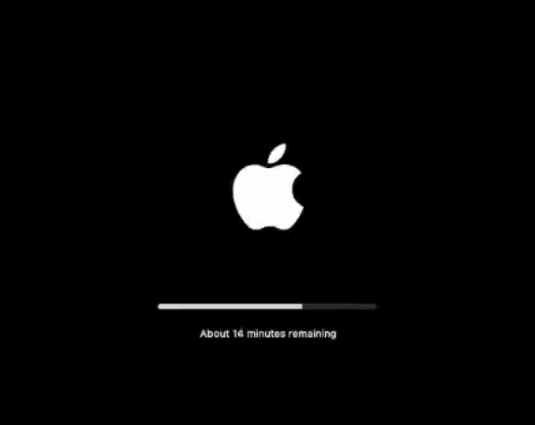
macOS Install
Select your language
From the macOS Utilities menu select "Disk Utility" and continue
Select the "VBOX HARDDISK Media" drive and press erase
Name the new drive whatever you like and press erase
Close out of Disk Utility and select "Install macOS"
Accept the terms and select the drive you just formatted and install
The installing of macOS can take a bit (~20min) depending on your hosts hardware.

Slide 31
macOS Setup
Select your region and keyboard
Press continue twice
You can sign into a iCloud account if you wish or you can skip and set up later
Agree to the terms
Create a computer account with name and password
Press continue twice
Follow the keyboard assistant instructions if it pops up

Slide 32
macOS Resolution change
Congrats! You're in macOS!
You might notice that macOS is stuck at 1024x768. To change that to your display's native resolution fully shut down the VM and VirtualBox.
To check your display's native resolution in Windows, go to Settings < System < Display < "Display resolution" to see the current resolution.
Some examples: 1920x1080, 2560x1440, 3840x2160

Slide 33
macOS Resolution change
Paste the command below into command prompt as an administrator. Make sure your still in the correct folder with the first "CD" command too. And change the resolution values to your display's native resolution.,
cd "C:\Program Files\Oracle\VirtualBox\"
VBoxManage setextradata "YOURVMNAME" VBoxInternal2/EfiGraphicsResolution 2560x1440

Slide 34
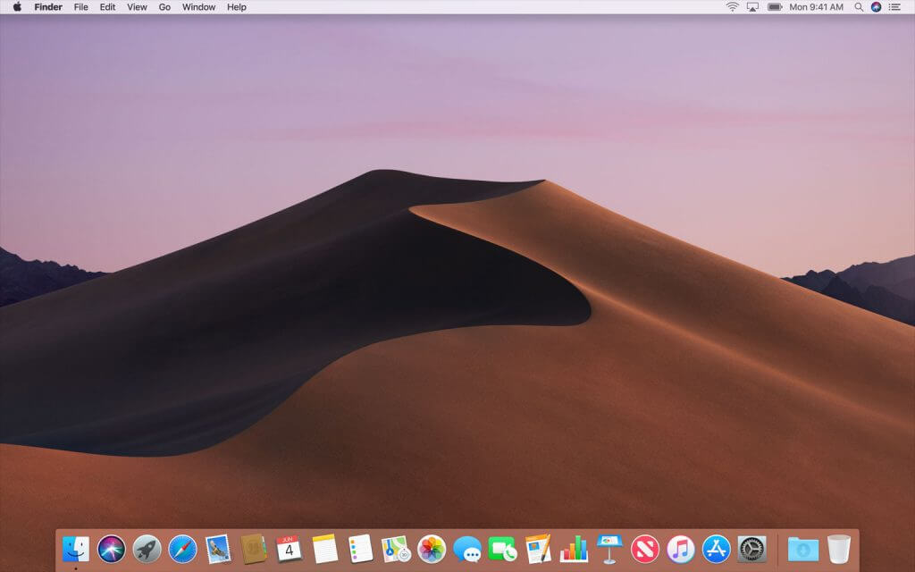
Open Virtual Box again
And press the Green arrow start button
Wait for macOS to boot and sign in
And you're done!

